Slide 1
An Introduction to
Data Structures

Slide 2
Goals
To understand the implementation of linked lists and to implement one of our own
To learn how to use the linked lists provided in the standard library
To be able to use iterators to traverse linked lists
To distinguish between abstract and concrete data types
To know the efficiency of fundamental operations of lists and arrays
To become familiar with the implementation of the stack and queue data types

Slide 3
Using Linked Lists
First, a quick demo: introDS\BankAccountExample
A linked list consists of a number of nodes, each of which has a reference to the next node
Adding and removing elements at arbitrary locations in a linked list is an O(n) operation
Visiting the elements of a linked list in sequential order is an O(n) operation
Random access is not as efficient as it is for other data structures we might use

Slide 4
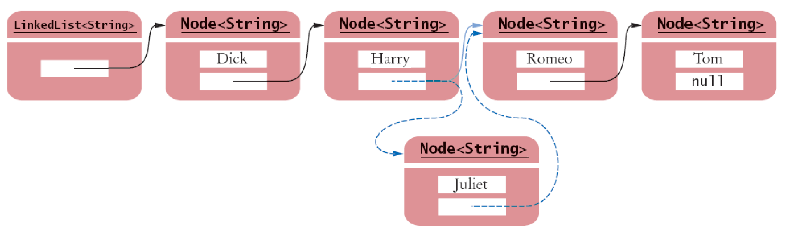
Inserting an Element into a Linked List

Slide 5
Java's LinkedList class
Generic class
  Specify type of elements in angle brackets: LinkedList<Product>
Package: java.util.LinkedList<E>
Easy access to first and last elements with methods
void addFirst(E obj)
void addLast(E obj)
E getFirst()
E getLast()
E removeFirst()
E removeLast()

Slide 6
List Iterator
ListIterator type
  Gives access to elements inside a linked list
  Encapsulates a position anywhere inside the linked list
  Protects the linked list while giving access

Slide 7
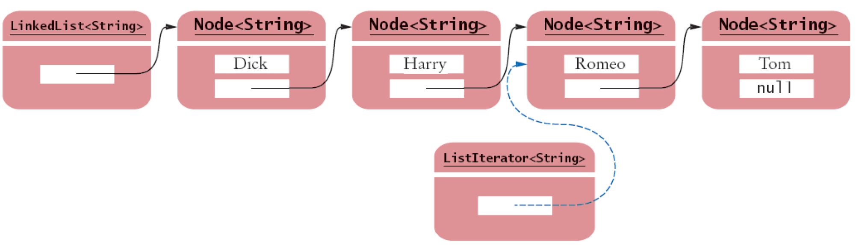
A List Iterator

Slide 8
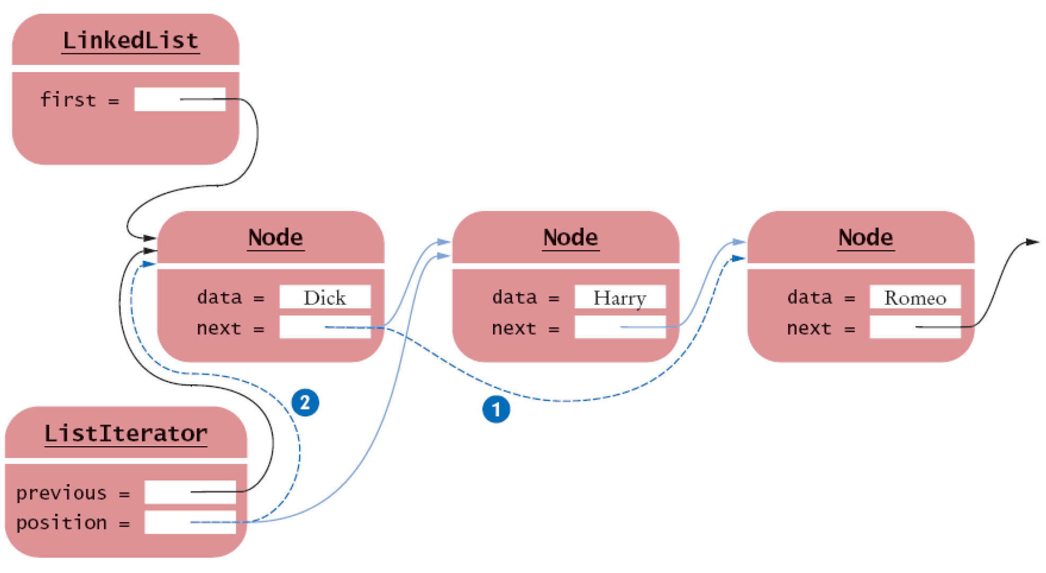
Removing a Node From the Middle of a Linked List (iterator version)
Removing a Node From the Middle of a Linked List

Slide 9
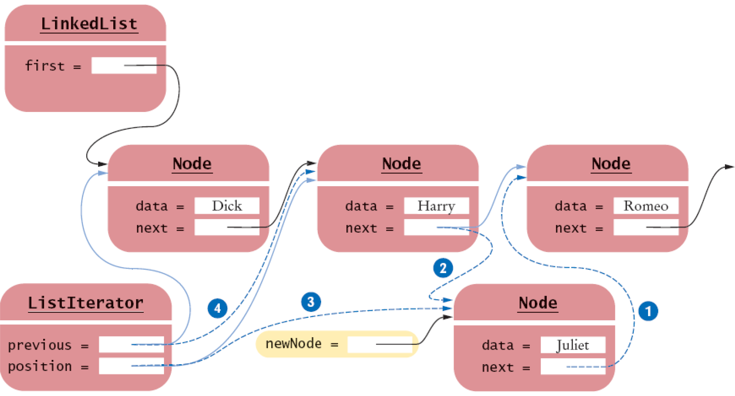
Adding a Node to the Middle of a Linked List
Adding a Node to the Middle of a Linked List

Slide 10
Sample Program
ListTester is a sample program that
  Inserts strings into a list
  Iterates through the list, adding and removing elements
  Prints the list

Slide 11
Implementing Linked Lists
Previous section: Java's LinkedList class
Now, we will look at the implementation of a simplified version of this class
It will show you how the list operations manipulate the links as the list is modified

Slide 12
Implementing Linked Lists
To keep it simple, we will implement a singly linked list
  Class will supply direct access only to the first list element, not the last one
Our list will not use a type parameter
  Store raw Object values and insert casts when retrieving them

Slide 13
Implementing Linked Lists
Node: stores an object and a reference to the
next node
Methods of linked list class and iterator
class have frequent access to the Node
instance variables

Slide 14
Adding a New First Element
When a new node is added to the list
  It becomes the head of the list
  The old list head becomes its next node

Slide 15
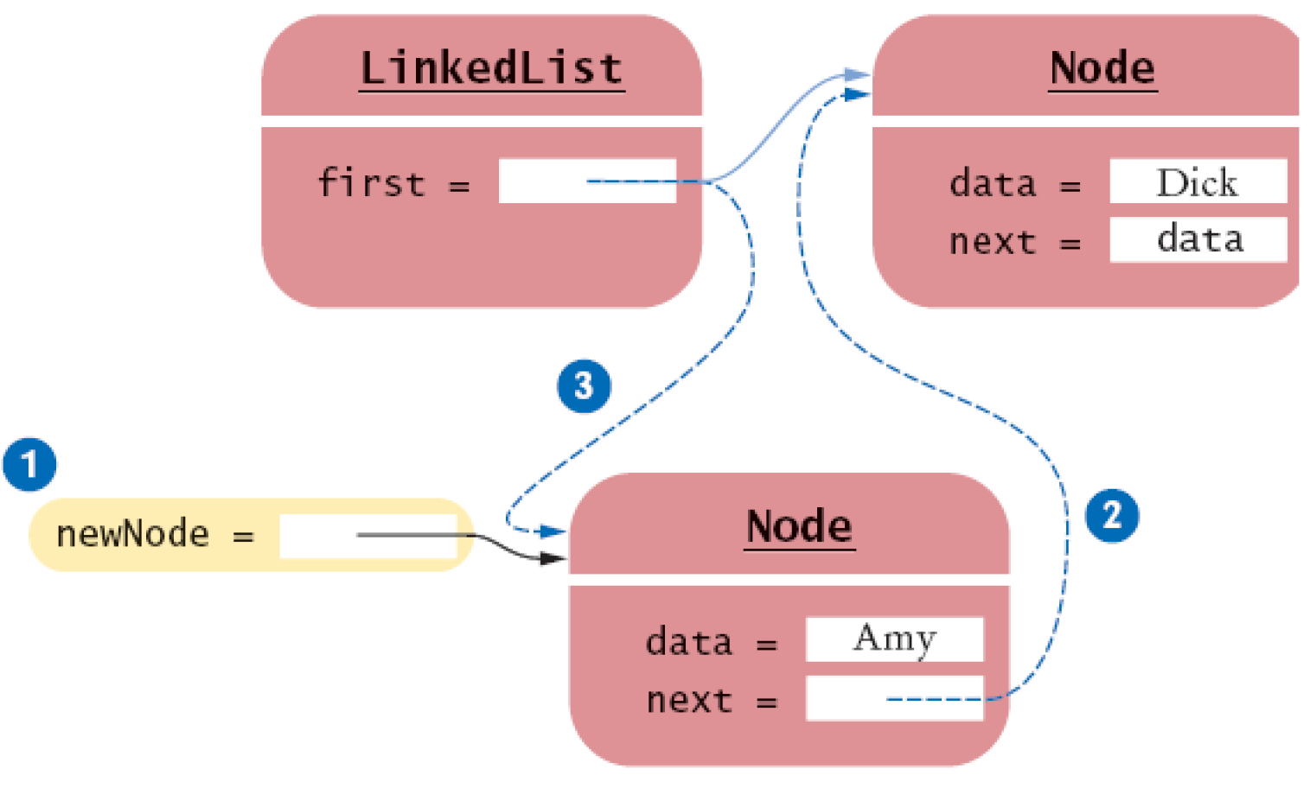
Adding a Node to the Head of a Linked List
null
4
Adding a Node to the Head of a Linked List

Slide 16
Removing the First Element
When the first element is removed
  The data of the first node are saved and later returned as the method result
  The successor of the first node becomes the first node of the shorter list
  The old node will be garbage collected when there are no further references to it

Slide 17
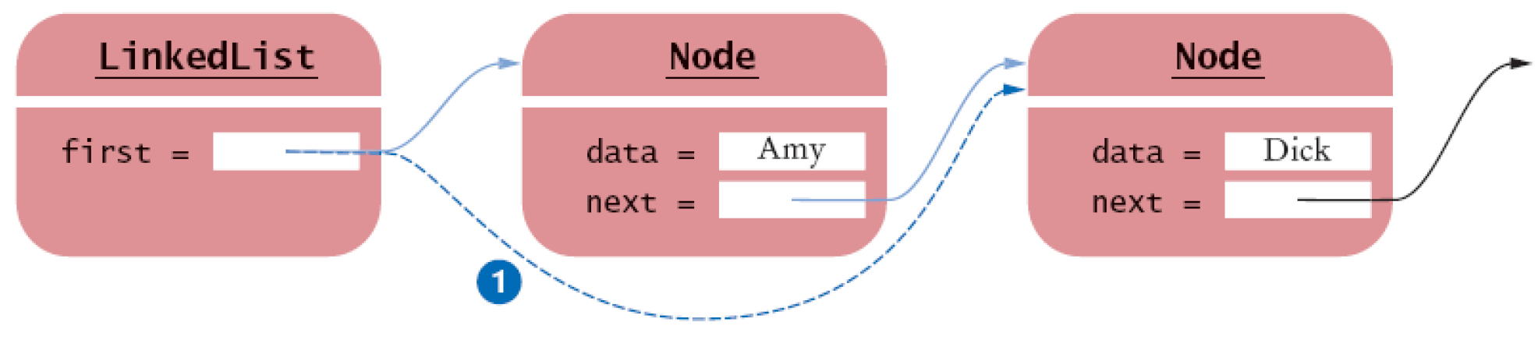
Removing the First Node from a Linked List
Removing the First Node from a Linked List

Slide 18
Abstract Data Types
There are two ways of looking at a list :
  Think of the abstract concept of a list
    Ordered sequence of data items
    Adding and deleting items is possible
    Traversing all items is also possible
  Think of the concrete implementation of the list
    Sequence of node objects with links between them
    Indexed data structure in contiguous memory

Slide 19
Abstract Data Types
Define the fundamental operations on the data
Do not specify an implementation

Slide 20
Abstract and Concrete Data Types
Concrete implementations of a linked list and an array-based list are quite different
The abstractions seem to be similar at first glance
To see the difference, consider the public interfaces reduced to their minimal essentials

Slide 21
Abstract and Concrete Data Types
More traditional terminology: array and list
Java library provides concrete implementations ArrayList and LinkedList for these abstract types
Java arrays are another implementation of the abstract array type

Slide 22
Efficiency of Operations for Arrays and Lists
Adding or removing an element in a Linked List
  Although a fixed number of node references need to be modified regardless of the size of the list, it costs n/2 on average to find the item
  In big-Oh notation: O(n)
Adding or removing an element in an Array
  On average n/2 elements need to be moved
  In big-Oh notation: O(n)

Slide 23
Efficiency of Operations for Arrays and Lists
Operation | Array | List
Access to a particular node | 0(1) | 0(n)
Linear Traversal Step | 0(1) | 0(1)
Add/Remove an Element | 0(n) | 0(n)

Slide 24
Abstract Data Types
Abstract list
  Ordered sequence of items that can be traversed sequentially
  Allows for insertion and removal of elements at any position
Abstract array
  Ordered sequence of items with random access via an integer index

Slide 25
Stacks and Queues
Stack: collection of items with "last in first out" (LIFO) retrieval
Queue: collection of items with "first in first out" (FIFO) retrieval

Slide 26
Stack
Allows insertion and removal of elements only at one end
  That end is called the top of the stack
New items are added to the top of the stack
Items are removed at the top of the stack
Traditionally, addition and removal operations are called push() and pop()
Think of a stack of dishes

Slide 27
Building a Stack
Basic Concrete Data Structures:
  Linked list data structure (top reference)
  Indexed (array) data structure (top index)
Two basic approaches:
  Utilizing a package such as java.util.LinkedList
  Building our own

Slide 28
Queue
Add items to one end of the queue (the tail)
Remove items from the other end of the queue (the head)
Items are removed in the same order in which they have been added
Think of people lining up
  People join the tail of the queue and wait until they have reached the head of the queue

Slide 29
Stacks and Queues: Uses in Computer Science
Queue
  Event queue of all events, kept by the Java GUI system
  Queue of print jobs
Stack
  Run-time stack that a processor or virtual machine keeps to organize the variables of nested methods (necessary for recursive algorithms)

Slide 30
Building a Queue
Similar to the approach to build a stack
Basic Concrete Data Structures:
  Linked list data structure (head and tail references)
  Indexed (array) data structure (head and tail indexes)
Two basic approaches:
  Utilizing a package such as java.util.ArrayList
  Building our own

Slide 31
Abstract Data Type Queue
Queue implementations in the standard library are designed for use with multithreaded programs
However, it is simple to implement a basic queue yourself

